Slide 1
Assessment of Teaching Redesign

Slide 2
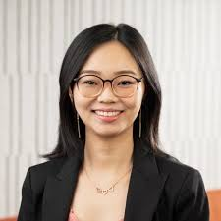
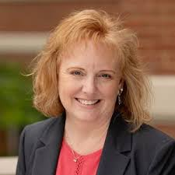
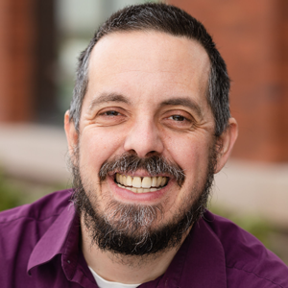
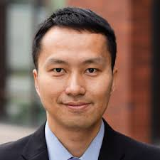
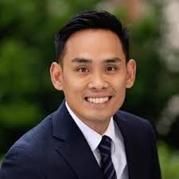
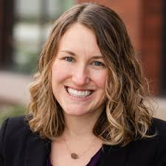
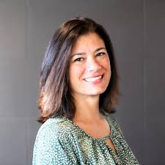
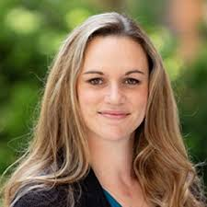
The Team
Terrence

Slide 3
Overall, the goal of this assessment redesign is to create more authentic metrics tied to our definition of quality teaching.

Slide 4
Quality Teaching
All faculty within the COB, regardless of rank, are expected to deliver quality teaching. Quality teaching, as defined at OSU, includes a commitment to inclusive practices, effective instruction that is practiced as a discipline, and support of learners. Key characteristics of quality teaching include:
Effective course design, with assessments and activities that align with course learning outcomes, and grading practices that reflect appropriate rigor and authentic assessment of learning outcomes.
Course design and student interactions that reflect a commitment to accessibility and inclusion;
Effective instructional methods, including: techniques to facilitate and promote student engagement and interaction; active learning; feedback and facilitation of learner growth; and clarity in course objectives and expectations;
Consistent preparation for class and ability to effectively organize and convey material to students in a manner appropriate for the course modality;
Up-to-date knowledge of relevant content and curriculum;
Knowledge of and ongoing development in curricular and pedagogical information, approaches, and techniques, and incorporation of this information into the classroom;
Contribution to curricular and course development.

Slide 5
2020 AACSB Standards
STANDARD 7: TEACHING EFFECTIVENESS AND IMPACT
7.1 The school has a systematic, multi-measure assessment process for ensuring quality of teaching and impact on learner success.
7.2 The school has development activities in place to enhance faculty teaching and ensure that teachers can deliver curriculum that is current, relevant, forward looking, globally oriented, innovative, and aligned with program competency goals.
7.3 Faculty are current in their discipline and pedagogical methods, including teaching diverse perspectives in an inclusive environment. Faculty demonstrate a lifelong learning mindset, as supported and promoted by the school.
7.4 The school demonstrates teaching impact through learner success, learner satisfaction, and other affirmations of teaching expertise.

Slide 6
Developing Structure for Assessments
Opportunities
Increase engagement & trust
Identify areas of improvement
Challenges
High stakes
Repetitive: occurs every year throughout career
Needs to be efficient; Supervisor may have 20-30 reviews annually.

Slide 7
Annual Evaluation Proposal: Key Principles
Supervisors retain discretion, particularly where student evaluations do not adequately reflect performance.
Student evaluations should not be the exclusive determinant.
“Meets” expectation should set a realistic but rigorous standard tied to our definition of quality teaching.
“Exceeds” should represent both the additional effort the instructor invests in the quality of their teaching and courses, and exemplary performance in the classroom.

Slide 8
Annual Evaluation Proposal: Data
ESET Q1/Q2 (track SLEs to assess moving to in future)
Canvas & Engagement observation rubrics (same applies for 3 years unless you request re-observation)
Reflection

Slide 9
Annual Evaluation Proposal: Reflection
Faculty prompted to identify teaching-related activities related to:
Professional (pedagogy) development
Course design and innovations
Also includes space to identify awards, additional teaching challenges (i.e., multiple preps, novice teacher, subject area) or class characteristics (upper v. lower division, class size, credits, etc.).
Faculty also prompted to set goals and identify strengths.

Slide 10
Annual Evaluation: Meets
Above 70% on Q1&2 (i.e., 4.2 out of 6)
Meets expectations in observations via Canvas/Engagement rubrics (lasts for 3 years)
Completed self-evaluation (supervisor reviews but no assessment is necessary; supervisor may refer to self-evaluation to support exercise of discretion)
Supervisor retains discretion to consider other factors, including class characteristics, which faculty are encouraged to identify in the self-evaluation form.

Slide 11
Annual Evaluation: Exceeds (meets +)
Exceeds on either Canvas or Engagement rubrics AND
Relevant, applied, and significant activities at a level that exceeds “meets” expectations in one or more of the following categories:
Professional development
Course design and innovations
Awards and certifications (such as QM)
Q1/Q2 scores that exceed expectations as viewed in relationship to specific course factors, including level (upper v. lower division, graduate/undergraduate), core/elective, number of students, number of credits).

Slide 12
Sample Reflection Prompts
We expect all faculty to engage in some professional development each year, such as attending faculty meetings, reading the Watercooler, attending 1 or 2 teaching-related workshops, and reviewing relevant periodicals or news sources. Examples of activities above the minimum expectations would include attending a multi-day CTL course design institute, being part of a Professional Learning Community, or attending an external, multi-day teaching conference.
Note that faculty are expected to keep courses and Canvas sites up to date and current. Examples of activities above the minimum expectations would include redesigning multiple course modules, new course design innovations, or significant redesign of course structure, assessments, or resources.

Slide 13
Annual Evaluation: Exceptional
Attains specific recognition as among the College of Business’s finest teachers, based upon a record of significant accomplishments, including, but not limited to, outstanding performance in teaching, dedication to the full development of students, knowledge of their discipline, and comparison with teachers across the university. Indicators of exceptional teaching include but are not limited to the recognition and/or nominations from OSU or relevant academic and professional societies.

