Slide 1

COLLEGE OF BUSINESS
NEW FACULTY ORIENTATION

Slide 2

Introductions
Your name
Your hometown
Your teaching area or role at the College or OSU

Slide 3
Getting Started Checklist
Technology
        Email
        ONID
        Canvas
        Classroom
        Required Trainings—FERPA!
Working with Students & Advising
Teaching
Professionalism and Student Communications
Exams and Grading Policies
Academic Misconduct
Teaching 101
Course Design
Engaging Lectures
Teaching Expectations
Inclusive Teaching

Slide 4
Who Do I Call?
Technology: COB Help
        Email
        ONID
        Classroom
Student registration issues: Advising
Course specific information: School Head and/or Course coordinator
Teaching Questions
Andy is available as a hub/router
Canvas questions (Andy or Canvas Help)
Student concerns
Academic misconduct
Question for School Head
Your schedule of classes
Absences, salary, travel
Annual evaluations
Average GPA

Slide 5

Teaching 101
A getting started guide
Notes:
Hello, and welcome to Teaching 101!

Slide 6

Teaching Is Hard (But Awesome)
“Inclusive, good-quality education is a foundation for dynamic and equitable societies.”
–Desmond Tutu
Notes:
I’d like to start off by sharing a quote with you:
“The best part about being a teacher is that it matters. The hardest part about being a teacher is that it matters every day.” –Todd Whitaker
This quote says a lot about the joys and challenges of teaching. There’s no doubt you’ll affect students and change lives in the classroom. You might be the person who motivates and encourages a student to try a new career path or a new area of interest, or you might be the person who challenges a student’s preconceived notions about the world we share. You might be the person to encourage a struggling student, or you may find a need to contact student support services when you see that the student is in crisis. Any way you look at it, what you do matters.
It takes a lot of time to create a good course. Great teachers are never “done.” Great teachers make mistakes. Don’t make the mistake of thinking you have to have everything perfect the first time, or that you can’t change things as you go. Innovate. Ask questions. Try. Improve. We’re here to support you in this journey.

Slide 7

Teaching Goals
Student Mastery of Learning Outcomes
This Photo by Unknown Author is licensed under CC BY-SA-NC
Student emotional development
Student professional development
?
?
Notes:
I’d like to start off by sharing a quote with you:
“The best part about being a teacher is that it matters. The hardest part about being a teacher is that it matters every day.” –Todd Whitaker
This quote says a lot about the joys and challenges of teaching. There’s no doubt you’ll affect students and change lives in the classroom. You might be the person who motivates and encourages a student to try a new career path or a new area of interest, or you might be the person who challenges a student’s preconceived notions about the world we share. You might be the person to encourage a struggling student, or you may find a need to contact student support services when you see that the student is in crisis. Any way you look at it, what you do matters.
It takes a lot of time to create a good course. Great teachers are never “done.” Great teachers make mistakes. Don’t make the mistake of thinking you have to have everything perfect the first time, or that you can’t change things as you go. Innovate. Ask questions. Try. Improve. We’re here to support you in this journey.

Slide 8
Backward Course Design
How Do We Get There?
Learning Outcomes: what should students be able to do at the end of class?
Assessments: how will I measure their achievement of these objectives?
Content: what content areas are necessary to support student achievement of the learning objectives?
Activities: how will I engage students with this course content in and outside of class?
Notes:
Backward course design is the opposite of what we might call content-centered design. In content-centered design, the instructor might start by making a list of chapters in a book they plan to cover, or topics they want to discuss. Then they plan their lectures, course activities, and tests based on the content they cover. Backward course design starts with the learning objectives and then works from there to identify content areas and classroom activities.
The key difference between these methods of course planning is that in the case of content-centered design, students might be left at the end of class asking, what was the point of the work I just did? Why did I read that chapter? What should I be able to do with this knowledge now that I have it? Backward course design is inherently functional—it starts by answering the question for students as to what they should be able to do, and then ensures the activities and content are aligned with that objective.

Slide 9
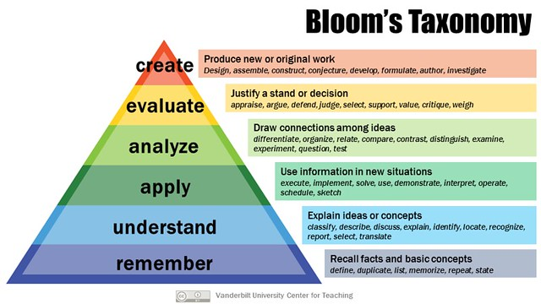
Learning Outcomes
Notes:
First of all, learning objectives. These should be the guideposts to creating your course. If you haven’t heard of learning objectives before, you can think of them as the name might suggest: the goals or objectives that you want your students to obtain or achieve as a result of taking your course. Put another way—what should students be able to do at the end of the course that they couldn’t when they began? What skills and knowledge should they have obtained?
The learning objectives should ideally be driving all of the decisions related to the course. In some cases, if you’re starting from scratch, you’ll be in a position to create these objectives. In other cases, you’ll inherit them from a course that has already been taught. In the College of Business, our core courses are based on learning objectives that relate back to the overall objectives we have for our degree programs. If you’re teaching one of our core courses, you’ll share learning objectives with all of the other instructors teaching that course.
The best learning objectives are stated in active terms, and can be assessed. A tool for creating good learning objectives is Bloom’s Taxonomy. As you move up the pyramid, the learning objectives become deeper and more complex, and higher level thinking skills are engaged. Now, not all courses will ask students to create or evaluate. On the other hand, if the only learning objectives a course has is memorization or understanding, we may be doing students a disservice by not exercising higher levels of thinking.
**
Image information: This graphic, Bloom’s Taxonomy, released under a Creative Commons attribution license, provides a quick overview of Bloom's taxonomy of the kinds of cognitive processes often asked of students in educational settings. The graphic reflects the 2001 revision of the original Bloom's taxonomy of educational objectives. For more on Bloom's taxonomy, see the Vanderbilt University Center for Teaching guide on the subject: cft.vanderbilt.edu/guides-sub-pages/blooms-taxonomy/. You can find a link to the image here: https://www.flickr.com/photos/vandycft/29428436431.

Slide 10
How Do People Learn?
Learning is based on drawing connections between prior knowledge and new knowledge.
Prior knowledge, experiences, and beliefs change how new information will be processed. This prior knowledge influences how learning will occur; it may inhibit or may create a foundation for learning.
Learners seek patterns and organization to integrate new knowledge into existing schema and make meaning of it.
Learners’ environment (including classroom climate) impacts how and what they learn.
Learners’ motivation and engagement impacts how and what they learn.
Notes:
https://www.youtube.com/watch?v=7nSe1VfAtww (2 minutes)

Slide 11
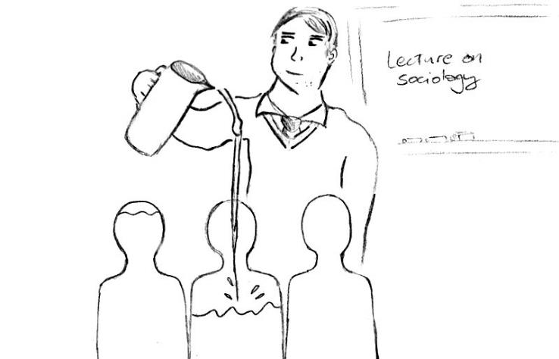
Lecturing?
Notes:
When are lectures great, and when do lectures not work to achieve our learning goals:
If your goal is to embed knowledge into a student, lecturing is a flawed way to do that. Lecturing, more than any other educational strategy, relies heavily on the empty vessel theory of learning. That doesn’t really work, for several reasons:
We know that students aren’t empty vessels. They come to us with lots of other knowledge and experiences, and to learn, they’ve got to connect the new information to that existing information. So you really can’t just pour stuff in without paying some attention to what’s already in there.
Learning is an active process of in which learns seek to connect information to existing information, and organize that information into a new view of the world. The empty vessel theory requires the learner to be entirely passive.
The empty vessel theory suggests that nothing matters other than the teacher, the student, and the information being embedded into the student. It ignores the impact of classroom climate & environment on learning.

Slide 12

Course Design: Active Learning & Engaged Lecturing
Limit lectures to 15-20 minute chunks
Mix in student engagement activities
Provide formative assessment
Build interaction between and among students
This Photo by Unknown Author is licensed under CC BY

Slide 13



Learning Resources
Notes:
The resources you’ll use to achieve your learning objectives include your course site on Canvas (OSU’s learning management system), as well as the books, articles, videos and other recordings you expect students to use during the course. Another resource that we increasingly incorporate into our courses is other students. We know our students learn best when they are part of a community, so many business instructors incorporate different forms of group and community learning activities into their courses.
Two things are important to note here; First, the days when all of your course content, assessments, and resources could be delivered fully face to face are gone. We expect, and our students expect, that you’ll have a functioning electronic course site where they can find information and access course materials, grades, your syllabus, and assignment details. Learning to create content on your Canvas course site and using Canvas to communicate with students is an essential part of your development as an instructor.
Second, just as with learning objectives, you may have the opportunity to select your resources, including any textbook you plan to use, or these decisions may be made by a course coordinator who is responsible for ensuring consistency across a course that has multiple sections and instructors. We know that the cost of textbooks can be a significant barrier to many of our low income students, so we strongly encourage our instructors to substitute low or no-cost open educational resources, where they are available and where they meet the course learning objectives.
Image: Ebooks vs Textbooks, by India Edu (https://www.flickr.com/photos/educationinindia/7703376790), CC x SA 2.0 (https://creativecommons.org/licenses/by-sa/2.0/). Note that the bottom of this photo was cropped.

Slide 14

Canvas
Essential Elements of your
Canvas Course Site
Welcome page—this is their first point of contact with you!
Start here—give them a place to find your syllabus, required course materials, how to communicate with you, etc.
Modules with learning objectives to organize assignments and activities.
Assignments with description, rubrics, due dates.
NOTE: Help is available!

Slide 15
Syllabi Requirements and Posting
Requirements included in The Watercooler newsletter at start of term
Faculty Services will send a survey at the beginning of each term to collect syllabi, which they will then post online.
There are a number of required syllabus elements, including statements about disabilities access services, student resources for mental health, and student conduct.
Syllabus should clearly describe your policies with regard to collaboration, sharing information, working together, plagiarism, and academic misconduct. For help, see DTLE.
All mandatory syllabus elements can be found in on COB Canvas page and on MyCOB.

Slide 16

Establishing Office Hours
Minimum of 3 hours per week.
Hours should be different
days, times to allow
maximum student access.
Report these to Faculty Services (FS) at beginning of each term. Office hours are collected via survey from Faculty Services along with syllabi each term.
Explain to students what they are!

Slide 17
Dead Week
  Academic Regulation #16:
  No final, midterm, or comprehensive examinations shall be given during the week preceding final examination week. (Examinations on laboratory work, course material covered by "weekly" or "section" quizzes, television courses, ROTC activities, and physical education activities are allowed.)
  Course work shall continue up to finals week. Final examinations shall be given during finals week in accordance with the finals week schedule. If a final examination is not to be given in a course, this action must be approved by the department with notification to the Registrar’s Office. Requests for changes in the time of final examinations will be submitted to the Registrar’s Office.
  **Academic Regulations: https://catalog.oregonstate.edu/regulations/#text
  **Final Examination Policies: https://registrar.oregonstate.edu/exam-policies

Slide 18
Midterms and Final Exams
Mid-Terms: Check with your course coordinator about details/expectations.
Finals: MBA final exams are scheduled at same time as class meetings and take precedence over the posted final exam schedule.
Final Exam Schedule: https://registrar.oregonstate.edu/final-examination-schedule-group-exams-class-meeting-hours
No final? COB approval required and notice to Registrar's Office (RO). Contact School Head.
Contact Carrie Stampe with questions or to request change to scheduled exam time.

Slide 19
Submitting Grades
Due by noon on Monday following Finals Week.
Prelim grades for graduating seniors due Spring Term (3 weeks earlier than final grades).
Grades are submitted online at MyOSU Portal: myosu.oregonstate.edu
Sign in with ONID username and password, choose “Faculty and Advisors,” then “Final Grade Menu” choice to enter your grades:
- Final Grades - Keyed entry
- Final Grades - File upload
- View Missing Final Grades
- Final Grades – Change Posted Grades

Slide 20
Grading
Use of “I” grade – incomplete
OSU standards control issuing of “I” grade. Instructor must also list the student’s grade if the incomplete work is not completed, which will become the grade for the course if no action is taken within one year.
Norms
Historical grade distribution norms exist for most classes. Likely to be variation among sections; staying close to COB norms promotes fairness for students having different instructors for same classes. Talk to your course coordinator and program leads, and discuss +/- grades, too.

Slide 21

TOOLS, RESOURCES, TECH

Slide 22
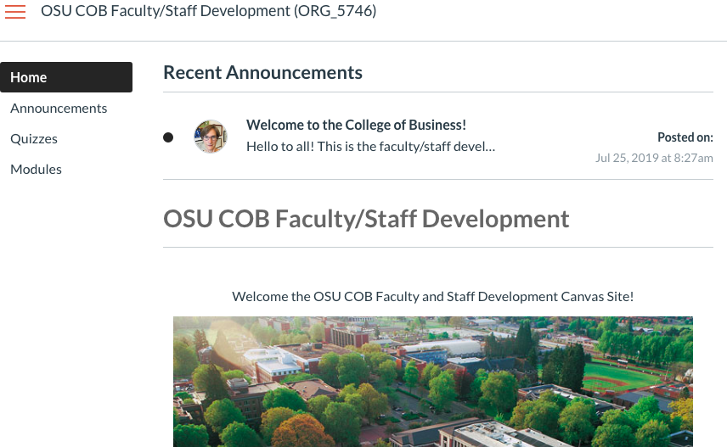
One Stop Shop—Faculty/Staff Development Site

Slide 23
Teaching Support
Faculty Services – 302 Austin Hall
Tracy Speelhoffer, Manager | Brian Seale, Office Mngr. | John Womack, Info Tech Consultant
* Printing/copying/scanning services for classes
* Office/building keys and access
* Student assistant hiring
* Office supplies, other support as needed - just ask!

Slide 24
ADVISING!
Advising works with COB majors, minors, and other OSU students who are interested in changing to one of our majors.
Many other majors on campus have business classes woven into their requirements, so more than COB students may be in your classes.
Students may ask you about:
  Access to a closed class
  BA/DSGN 410 Learning Agreements
  Pre-Req waivers
  Grade Changes
  Withdrawing from your class or from the term due to hardship
  Incompletes
  Signing a Late Change of Registration petition
To graduate, students need:
  A grade of C- or higher in COB program courses
  An OSU COB GPA of a 2.5

Slide 25
Administrative & Teaching Support – University Resources
OSU Service Desk: x7-3474, also for info about OSU site licenses
Classroom computer support is supported by OSU Service Desk
https://is.oregonstate.edu/service-desk
- Phone is under console if trouble logging in
- Use ONID ID & password to access.
Valley Library: databases available, put class materials on “reserve” for use by students for classes.

Slide 26
Laws and OSU Policies – Student Privacy & Family
Education Reporting Privacy Act (FERPA)
You may NOT disclose student information without explicit consent.
Do not pass graded materials to students in class to select their own work or leave outside your office for pick-up.
Do not discuss student-related matters with parents or other family members without signed written approval from student. (See: https://registrar.oregonstate.edu/privacy-records)
Do not hand a student their paper in a way that allows others to see grades.
Do not pass back assignments high score to low score or verbally congratulate students in the presence of other students.

Slide 27
Laws and OSU Policies – Student Privacy & Family
Education Reporting Privacy Act (FERPA)
Do not provide students pictures of other students without their explicit consent.
Do not require students to post information on the web that contains their name or other identifying information.
Your student assistant may have access to grade information. However, they must know the privacy rules. (When you hire the assistant, Faculty Services will have them go through the FERPA training, just as you have.)
You may use Canvas to post student grades.
????s - https://registrar.oregonstate.edu/privacy-records; can’t find what you need? Contact ADTLE.

Slide 28
Student Evaluations (SLE)
Student evaluations are auto-prompted by the University for students to complete online. You don’t have to do anything to initiate the process.
Students are not required to complete evaluations.
Evaluations currently in flux (during pandemic, have not been available to supervisors).
Faculty can view all results.

Slide 29
Academic Misconduct
Contact Andy Olstad, COB Hearing Officer, if you suspect academic misconduct.
OSU Student Conduct web page is located at http://oregonstate.edu/studentconduct/
OSU definitions and prevention measures and tips:
  http://Academicaffairs.oregonstate.edu/faculty-handbook/appendix-academic-dishonesty

Slide 30
Teaching Information – Miscellaneous
Title IX
Mandatory Child Abuse Reporting – we are mandatory reports, on and off campus
Legal obligations for OSU employees: http://hr.oregonstate.edu/training-topics/mandatory-reporting-child-abuse (Contact HR for more info if needed.)

Slide 31
Questions?

