Slide 1
EFFECTIVE Teaching: evidence-BaseD Practices
September 14th, 2023.
Regan A. R. Gurung Associate Vice Provost and Exec. Director, Center for Teaching and Learning Professor of Psychological Sciences
Twitter: @ReganARGurung

Slide 2
WHAT’S THE EVIDENCE?

Slide 3
What works.
Just In Time Teaching
Feedback
Structure
Interteaching
Retrieval Practice
Active Learning
Enthusiasm
Organization
Spaced Practice
What Does Not Work
What Does Not Work

Slide 4
DISTINGUISH
Promise
Efficacy
Effectiveness
Implementation
Notes:
DISTINGUISH

Slide 5
Context Matters
Frequency of use
Discipline
Class size
Course level
University size
Geographical location

Slide 6
EXEMPLARY PRACTICES
Notes:
exemplary

Slide 7
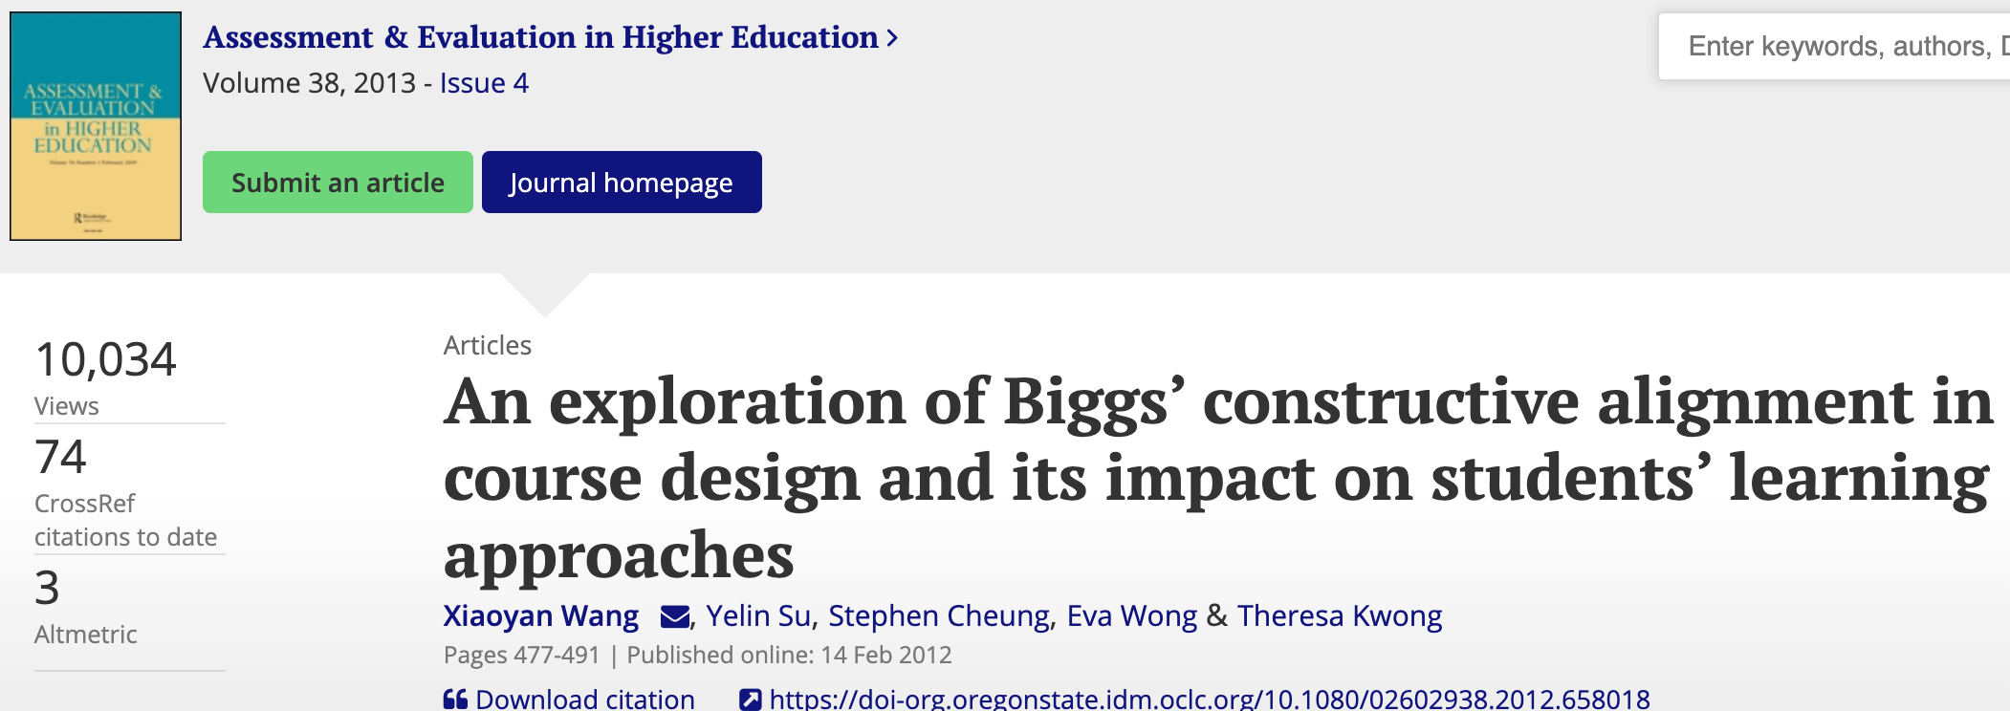
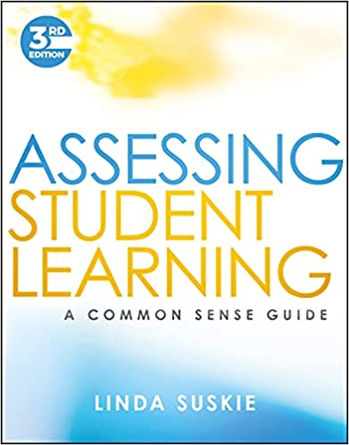
Establish Clear Learning Outcomes

Slide 8
Inclusive Teaching
All learners feel welcome, valued, & safe.
Different ways to participate.
As seen in UDL [bit.ly/CTL_UDL]
Highly structured courses reduce gaps.
Notes:
Select Diverse authors.
Watch for examples that bias.
Establish rules of civility.

Slide 9
Create Student-Centered Syllabi
Notes:
Following Chickering and Gamson’s (1987) description of the seven principles of good practice in undergraduate education, researchers have attempted to measure and increase the use of learner-centered approaches to teaching.
Why is the syllabus important?
Can effect the perceptions of teacher effectiveness (Saville et al., 2010)
Although syllabi provide students with important course information, they can also affect perceptions of teaching effectiveness. To test this idea, we distributed 2 versions of a hypothetical course syllabus, a brief version and a detailed version, and asked students to rate the teacher of the course on qualities associated with master teaching. Students in the detailed syllabus group rated the teacher as possessing more of these qualities; they were also more likely to report that they would recommend the course to others and take another course from the teacher. Thus, in addition to serving a communicative function, a detailed syllabus might signal to students that their teacher is competent and wants them to do well.
It can empower students.
After we gave 2 classes of introductory psychology students the syllabus, the first class (the experimental group) generated rules for classroom behavior. The instructor presented the second class (the comparison group) with the list of rules and said they were instructor generated. Students rated the rules, several aspects of the course, and the instructor. The comparison group (n = 88) reported higher frequencies of negative behavior by class members. Students in the experimental class (n = 62) rated the instructor more positively. The groups did not differ in grades, perceived fairness, or perceived importance of the rules.
Can influence perceptions on the first day, which in turn can affect student motivation in the course (Wilson & Wilson, 2007)
Teaching experts assert that the first day of class impacts students, with potential negative effects lasting the entire term. However, no empirical research supports this supposition. We randomly assigned students to view a video of their professor either providing a positive or negative first-day experience. Students with the positive experience reported better attitudes and more positive expectations at the end of the first day. Although several differences dissipated by the end of the first week, students with the positive first-day experience reported higher motivation for the majority of the course, and their grades were significantly higher by the end of the term

Slide 10
PRAGMATICS & POSSIBILITIES

Slide 11
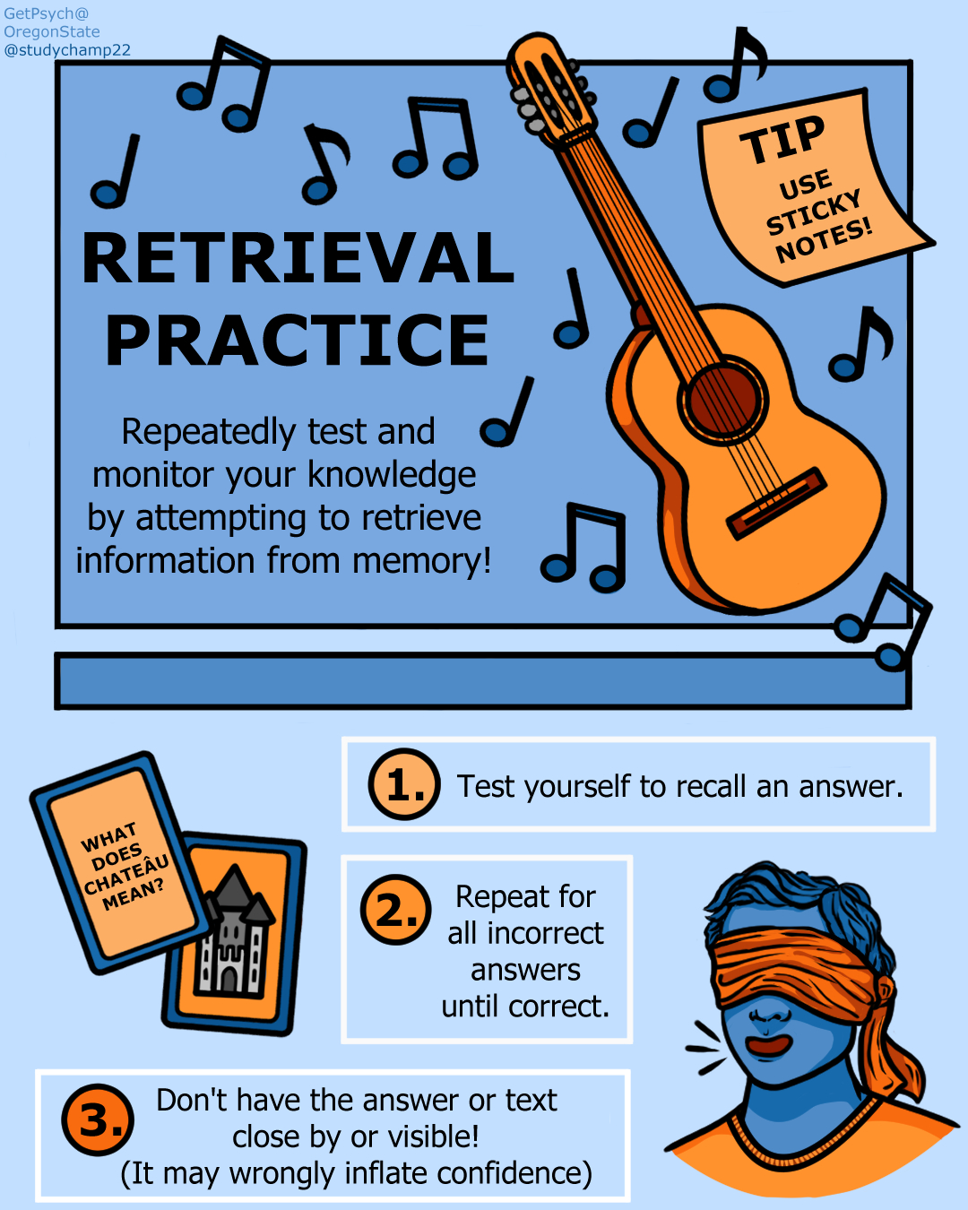
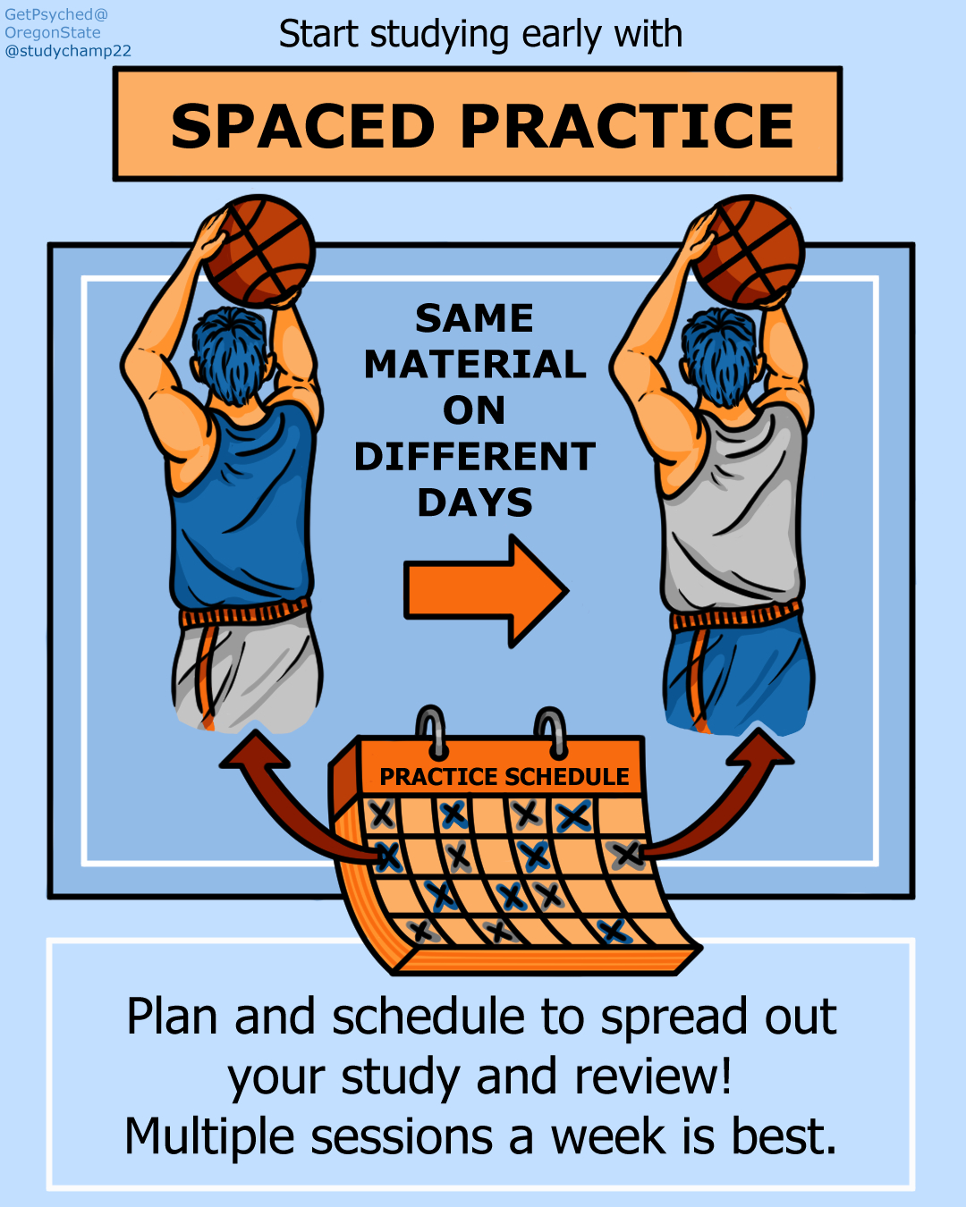
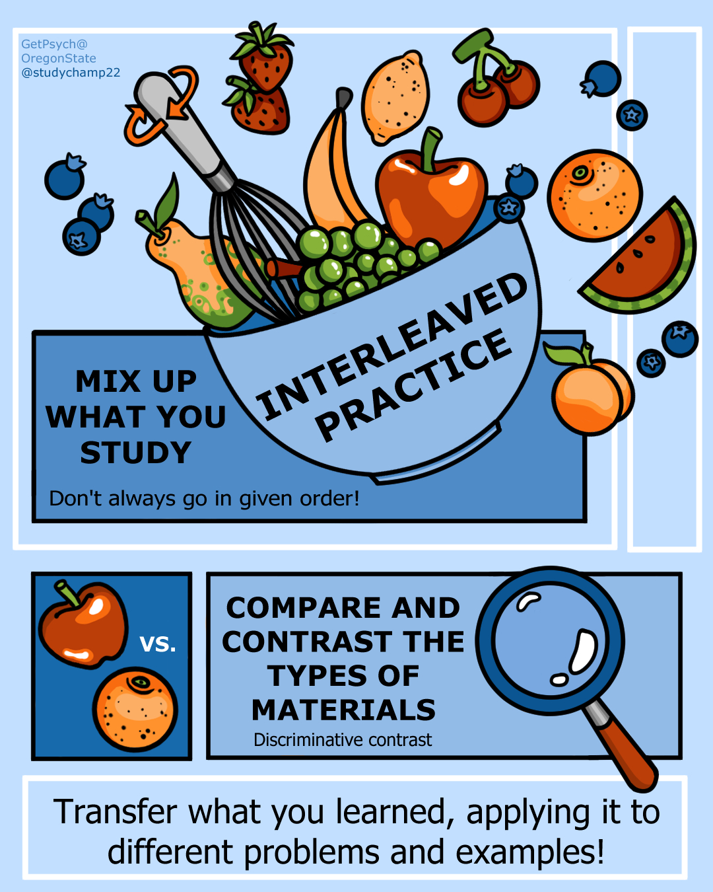
Evidence-Based STUDENT practices

Slide 14
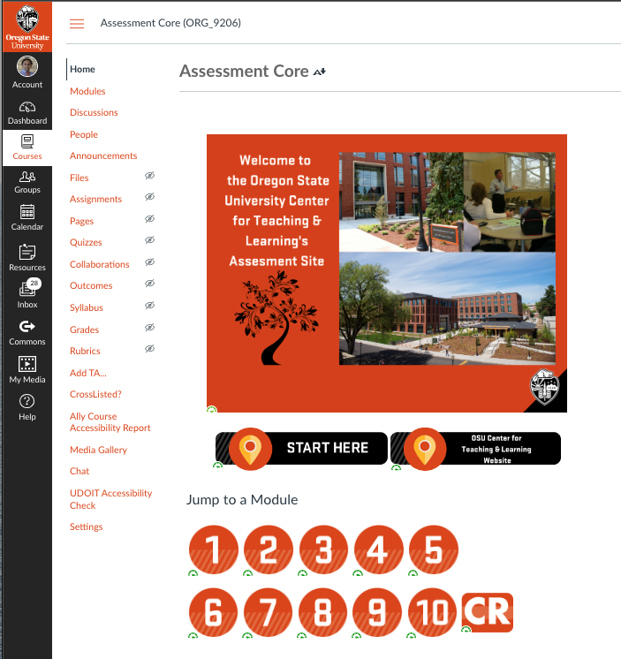

Slide 15
To Evidence-informed teaching
@ReganARGurung

